Slide 1
Capstone Project The Battle of the Neighborhoods
Jozef Mito

Slide 2
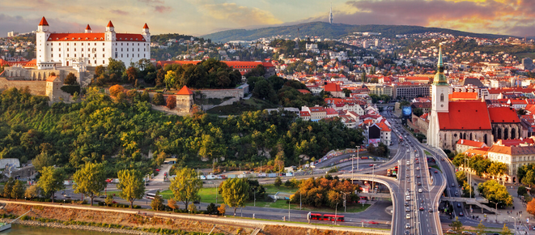
Business Problem & Background
The objective of this project is to analyze where to open a new restaurant in Bratislava (Slovakia) and recommend the type of restaurant. Bratislava has many good restaurants which are concentrated in the city center.
The data science tools will be used to find best new place where the restaurant would have a chance for good attendance, and it will be close to the City center and at the same time to recommend what type of restaurant is missing.
Target audience - Investors looking for opening a new restaurant in Bratislava, Slovakia.

Slide 3

The Data - how it will be used
Data / Factor to be considered is: - Number and types of existing restaurants in the neighborhood
Sources of data for the analysis:
Foursquare API as a source of data - number of restaurants, their type, location
Bratislava Neighborhoods html data from https://sk.wikipedia.org
Methods used to solve the problem:
Use Bratislava Neighborhoods data and enrich it with information from Foursquare,
Create Pandas data frame,
Use K-means
Sept 19, 2020

Slide 4
Methodology section
Download libraries needed to perform data analysis – Pandas, Geopy, Sklearn.cluster, Nominatim
Download dataset from Wikipedia. After data wrangling, cleansing and translating columns headers, the dataset will have four columns namely - Borough, Neighborhood, Latitude and Longitude. and create Panda data frame of Bratislava's Neighborhoods.
Foursquare Data - The Neighborhood's Latitude and Longitude from the dataset will be used to download the data of all Food Venues from Foursquare using the Food Category ID of '4d4b7105d754a06374d81259'
Sept 19, 2020

Slide 5
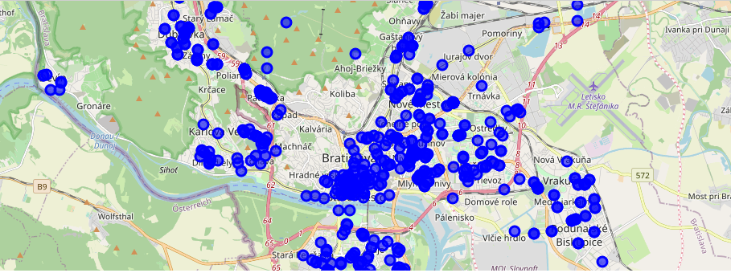
Visualization of the data on Folium map
To visualize the Food Venues data the Folium map will be used.

Slide 6
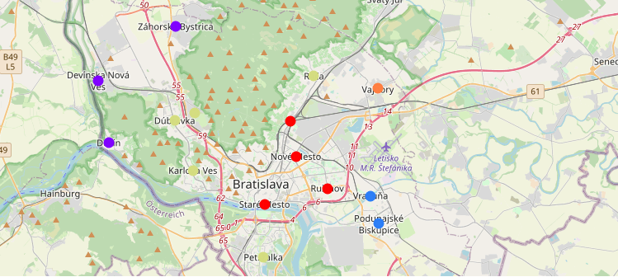
Results - visualization of the resulting clusters
The Elbow Point Technique was used to define the optimal number of clusters. The best K value is chosen at the point in which the line has the sharpest turn. In my case, the Elbow Point is at K = 7.
The neighborhoods will be clustered based on their most common venues:
Sept 19, 2020

Slide 7
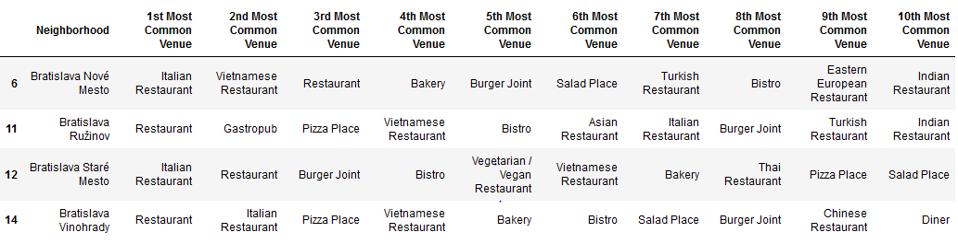
Observations and recommendations
CLUSTER 0 - The analysis is showing that most of restaurants are in the Neighborhoods - Stare Mesto, Nove Mesto, Ruzinov a Vinohrady. The cluster 0 is rather saturated with restaurants and there is a good diversity of all kinds of restaurants.
Recommendations for this cluster:
Neighborhood Ružinov - open an Italian restaurant
Neighborhood Nove Mesto - in Neighborhood Nove Mesto there are 2 districts - Kramare, Koliba which are high-end residential areas but there are no restaurants. One of my recommendation is to start restaurant in that area - it can be a luxury Italian or some general restaurant.
Sept 19, 2020

Slide 8
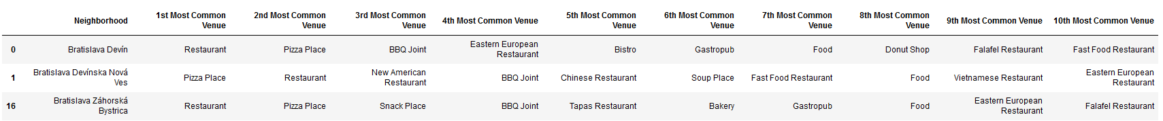
Observations and recommendations
Cluster 1: The outskirts of Bratislava - small number of restaurants but there are also smaller number of inhabitants. No recommendation for this cluster.
Cluster 2: the Bratislava outskirts - small number of restaurants but both neighborhoods have quite good number inhabitants.
Recommendations for this cluster: open an Italian restaurant in any of these two neighborhoods.
Sept 19, 2020

Slide 9
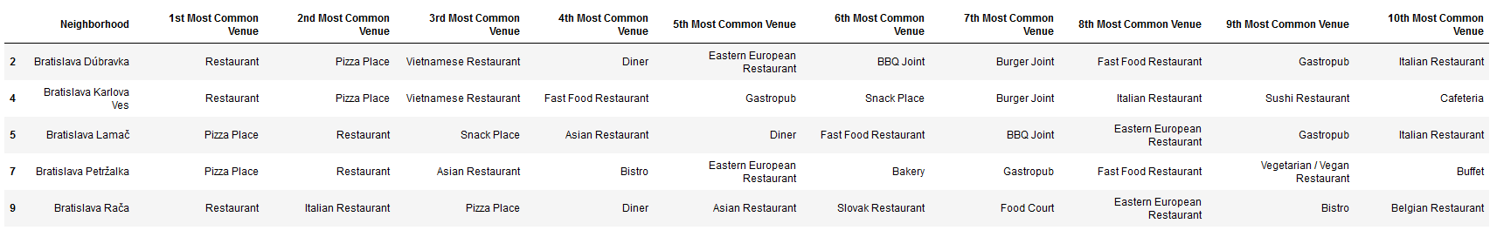
Observations and recommendations
Cluster 5 - the most of Neighborhoods are in this cluster. General restaurants and Pizza places are most common food venues. These are mostly residential Neighborhood.
Recommendations for this cluster: open an Italian restaurant in Neighborhood Petržalka.
Sept 19, 2020

Slide 10
Conclusions
Objective of this project was to analyze food venues in Bratislava and come with recommendation for a new restaurant.
This analysis used data science techniques. Final decision will require analysis also from financial, environmental, traffic and other perspectives.
Considering the above data I would recommend the following options : 1. Opening of Italian restaurant Neighborhood Nove Mesto in district Koliba
2. Opening Italian restaurant in Neighborhoods - either in Ruzinov or Petrzalka.
Sept 19, 2020

Slide 11

THANK YOU!

